Slide 1
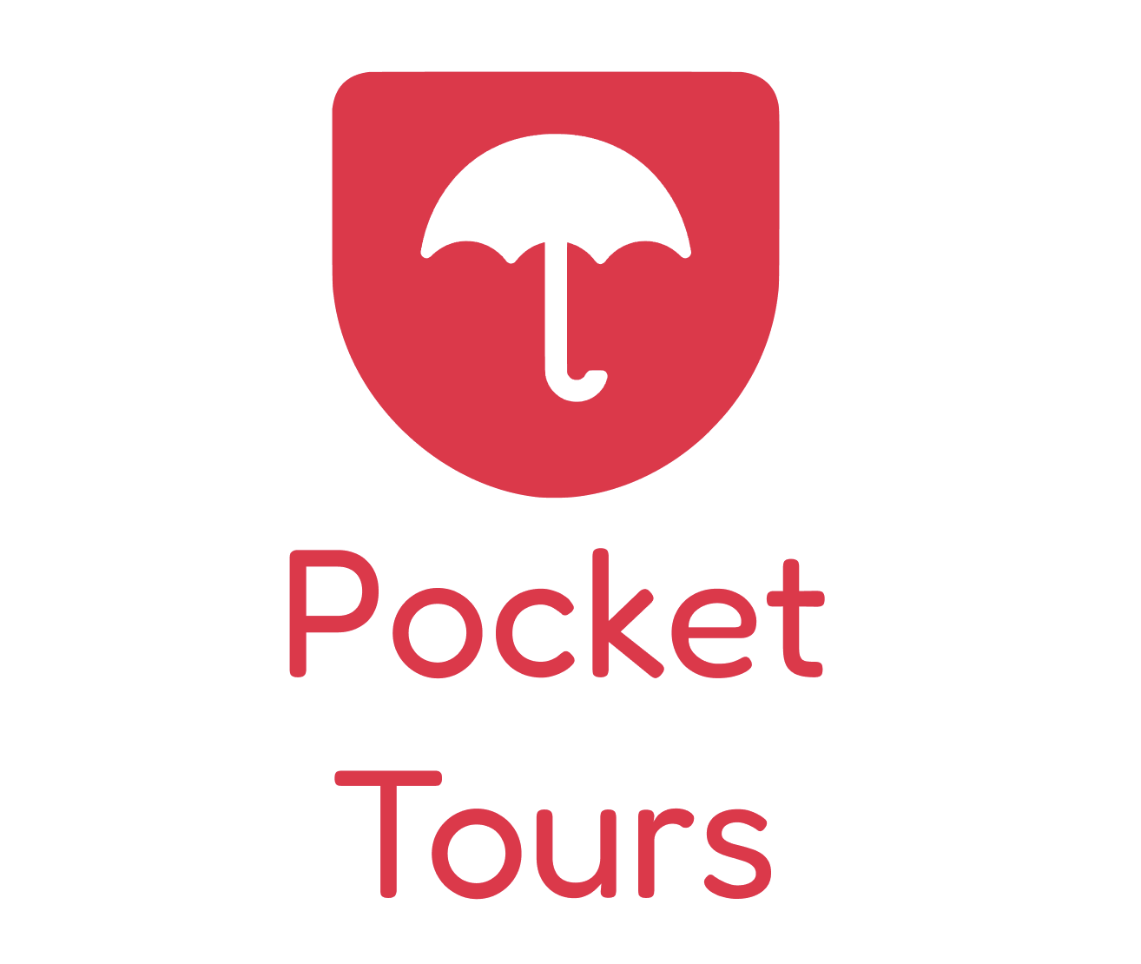
City tours in your pocket

Slide 2
Problems
Tour Guides
… often find themselves underappreciated and underpaid;
… lack control over their working hours and are overly reliant on companies for creative direction.
Something needs to be
DONE.
Tourists
… often face limitations in their tour experiences;
… lack flexibility in tour scheduling, desire more diverse tour categories/destinations and sometimes find tour prices to be prohibitive.
Self guided tours’ apps:
…can’t produce enough professional content for the whole world;
… offer limited solutions at high prices;
… are new to the market and didn’t find the right way to approach it
pockettours.com
city tours in your pocket
@2024

Slide 3
SOLUTIONS
AN APP FOR EVERYONE
Pocket Tours: the revolutionary app empowering anyone to curate and customize their dream journeys, anywhere in the world, at their fingertips.
Everyone can become a
STORYTELLER.
A NEW WAY TO DISCOVER THE WORLD
In an intuitive manner, tourists can choose from various categories of tours, where they want and when, while seamlessly listening and interacting along the way, all for almost nothing.
SUPER TARGETED MARKETING
A groundbreaking approach to reaching tourists: advertisers can now ensure their ads capture attention as users listen while physically passing by their shops, monuments, attractions and more!
pockettours.com
city tours in your pocket
@2024

Slide 4
BOOSTING TOURISM
Enhancing local experiences
Local means… local
Allowing local residents to create and sell their own tours can boost the region's economy. Pocket tours promotes the sharing of local knowledge, authentic stories, and unique experiences, while also providing an additional source of income for residents.
Personalised adventures
Tourists can discover tours tailored to their specific interests.
The app increases the likelihood of exploring lesser-known places and experiencing the local culture in a more authentic way, most probably with tours made by locals!
pockettours.com
city tours in your pocket
@2024

Slide 5
Target Market
The Guides
Anna, 32
Anna, 35, is an art and history professor who’s passionate about bringing museums to life through her pocket tours, focusing on the art displayed in her hometown, Edinburgh. Thanks to Anna's pocket tours, travelers gain a deeper understanding of the artwork and exhibits, enhancing their museum experience with her expert guidance.
An archaeologist dedicated to sharing the wonders of ancient civilizations with curious travelers. He uploads pocket tours featuring in-depth explorations of archaeological sites in Rome, such as the Colosseum. Tourists visiting Rome listen to Michael's pocket tours to enrich their experience as they wander through the ancient ruins.
David, 45
The Tourists
Alex, 45, is on a business trip to Rome. During his downtime, he enjoys immersing himself in the local culture and history. Luckily, a pocket tour about ancient Roman civilization provides him with valuable insights as he strolls through the city's historic streets.
Alex, 37
is a travel enthusiast who recently arrived in Tokyo for a vacation.
She's always been fascinated by Japanese history and culture, and she's eager to explore the city while learning about its rich historical background through a bunch of pocket tours made by locals.
Emma, 28
pockettours.com
city tours in your pocket
@2024

Slide 6
Value proposition
Pocket Tours stands out by allowing anyone to create tours for the app.
This fosters a vibrant community-driven ecosystem, offering a wide variety of perspectives, ensuring an engaging limitless dynamic experience for everyone.
pockettours.com
city tours in your pocket
@2024

Slide 7
Business Model
Guides | Post a tour: Pick a category (history, culture, interactive, museums, treasure hunts, night walks…); description, map path; audio file; recommendations (souvenirs, food, monuments, other tours…); set a price and… MARKETIZE THEIR OWN TOURS | We get 20% Out of every tour sold
Tourists | Use the simplest version of the app for free with advertisements. Can also subscribe to a premium version to remove ads and gain access to better features such as: offline listening, guaranteed better sound quality, and access to discounts. | For only 12$ a year
Advertisers | Pay to advertise in the app and also specifically during the audio of the tours. | Unlimited possibilities
pockettours.com
city tours in your pocket
@2024

Slide 8
Competition I
Traditional Tours | Tours organized by travel agencies or specialized companies, with professional tour guides. Advantages: They provide a guided experience with detailed information. Limitations: High costs, fixed schedules, and lack of customization. | Ex: Civitatis; Exodus Travel; Trafalgar
Free Tours | Tours conducted by local guides or volunteers, usually relying on tips. Advantages: Accessible for travelers on a limited budget. Limitations: Variable quality and consistency, dependent on the availability of guides. | Ex: Guruwalks; SANDMAN’s; Walkative
Self guided Tours | Tours where tourists explore on their own, following printed or digital itineraries and guides. Advantages: Complete flexibility in schedules and reduced costs. Limitations: Content limited to the number of professionals in the app. | Ex: VoxCity; Walkbox; PocketGuide
pockettours.com
city tours in your pocket
@2024

Slide 9
Competition II
 | Pocket Tours | Free Tours | Traditional tours | Self Guided Tours Apps
Price | 1€ - 5€ | 15€ - 20€ | 50€ - 250€ | 3€ - 20€
Convenience | Great | Not much | Not much | Great
Possibilities | Endless | Limited | Ok | Ok
Content limit | Unlimited | Limited | Limited | Limited
Awareness | Can become huge | Not much | Common | Not much
Advertisement | Unlimited | Some | None | None
pockettours.com
city tours in your pocket
@2024

Slide 10
Go To Market Plan
Positioning the Pocket Tours brand as the app that allows anyone to
become a storyteller.
Leverage the public's unfamiliarity with this alternative and present it as
a new way to explore a destination.
Create content. Reach out to as many travel influencers as possible and encourage them to create tours on the app. Make them the first "ambassadors" and let them promote their tours on their networks, which becomes free marketing for Pocket Tours.
Create referral campaigns for tourists.
Run targeted digital advertising campaigns aimed at tourists.
pockettours.com
city tours in your pocket
@2024

Slide 11

Business Roadmap
Business Plan
Financial Forecast
Product Dev
Pre Seed Round
Concept
Market Research
Team
Launch in Europe
CALL FIT
Portugal ventures
pockettours.com
city tours in your pocket
@2024

Slide 12
Investment Rounds
Portugal Ventures Call FIT
Marketing
Business Operations
Product
Total
Pre-Seed Round (9 months after)
Marketing
Business Operations
Product
Total
12.650€
170.500€
40.024€
8.170€
97.326€
71.330€
150.000€
250.000€
pockettours.com
city tours in your pocket
@2024

Slide 13
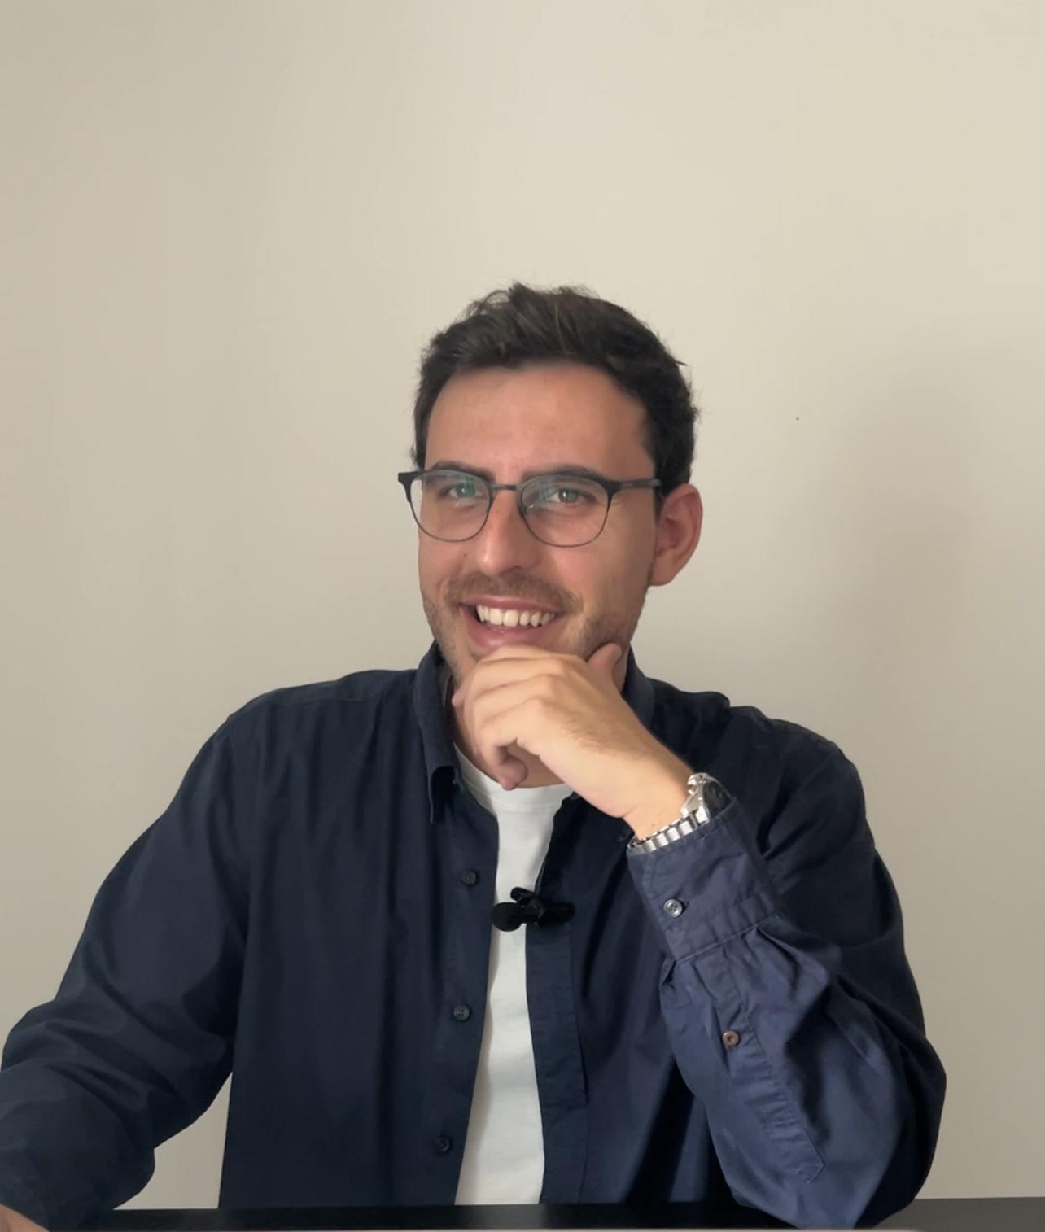

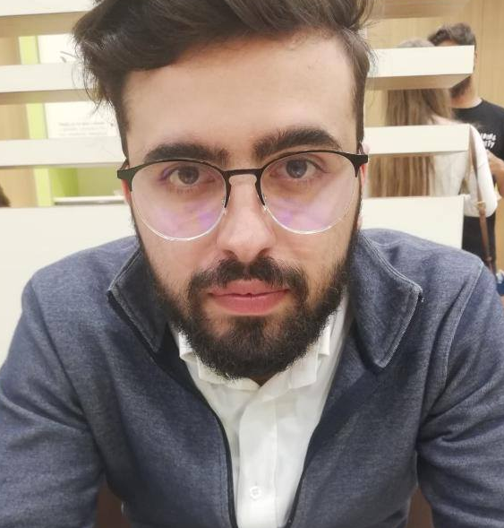
Management team
 | Guilherme Fernandes | CEO | COO - MedTech Umedicu Co-founder - SportsTech Nordensa.com Innovation manager Heraldist & WM Entrepreneurship Professor I.S.C.A.L. | +30 countries +100 cities +50 tours
 | Francisco Quinteiro | CPO | Software & Connectivity Edge Developer Siemens Computer Science U.A.L.G. | +10 countries +30 cities +10 tours
pockettours.com
city tours in your pocket
@2024

Slide 14
Thank you!
pockettours.com
city tours in your pocket
@2024

Slide 15
pockettours.com
city tours in your pocket
@2024

